Slide 1

Cognitive Language Processing for Rosie
Peter Lindes
University of Michigan
37th Soar Workshop
7 June 2017

Slide 2
Rosie
A Soar agent for interactive task learning
ROSie
Learns novel games [Kirk and Laird, ACS 2016]
Learns fetching and delivery tasks [Mininger and Laird, ACS 2016]
This is how we know if it understands.

Slide 3
Example Sentences
Red is a color.
The large one is red.
This is a big triangle.
Store the green block.
What is inside the pantry?
It is on the big green block.
Move the green block to the left of the large green block to the pantry.
Pick a green block that is larger than the green box.
If the green box is large then go forward.
Move forward until you see a doorway.

Slide 4
Rosie Parser (2015-2016)
Linguistic processing knowledge written by hand
Ad hoc lexical and construction knowledge written by hand
Soar
Long-Term Memories
Procedural
Semantic
Episodic
Reinforcement
Learning
Chunking
Decision Procedure
Episodic
Learning
Working Memory
Visual Buffer
controllers
Perception
Action

Slide 5
Lucia
A language comprehension system for Rosie
Goals:
Embedded in Rosie
Produces grounded meanings
Results are actionable
Efficient: runs in simulated real time
Scalable to a wide range of language
Cognitive: models aspects of human language processing

Slide 6
Motivation
Why would we want to build a cognitive computational model of human language processing?
Some personal experiences

Slide 7
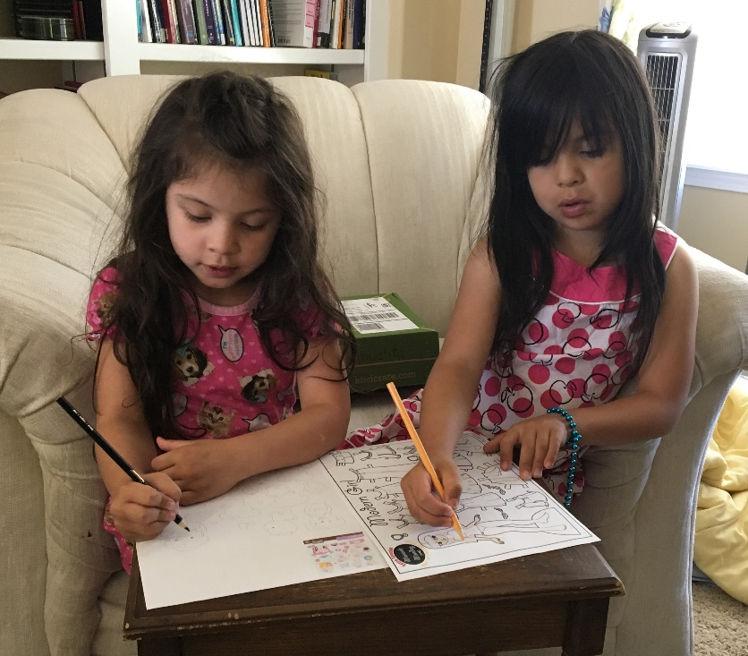
Me gusta dibujar muchas cosas.
A mí también, y con muchos colores.
How do they do that?

Slide 8


Blah, blah, blah ...
in English
How does he do that?
Blah, blah, blah ...
en español

Slide 9


Rosie, please clean up the kitchen.
How can we get it to do that?

Slide 10

How do they do that?
How does he do that?
Science
informs engineering
Engineering
informs science
How can we get it to do that?

Slide 11
Two interrelated questions:
How does human processing work?
How can we make robots understand us?

Slide 12
A possible answer:
Build a cognitive computational model of how humans process language.
Where do we get the knowledge?
Will it actually work with a robot?

Slide 13

How to model cognition
Computer Science
How to represent language knowledge
Linguistics
Soar
Embodied Construction Grammar (ECG)
Pick up the green sphere.
Comprehender
The
Lucia solution
How human language processing works
Psychology
Incremental, single path processing

Slide 14
Sentence Processing in Lucia
Translator
ECG Grammar Files
Grammar Rules
Context Rules
Action Messages
Comprehender
Rosie Operations
Pick up the green sphere on the stove.
Input Words
World Model
Soar Agent
Ontology

Slide 15
Linguistic processing knowledge written by hand
Lucia in Soar
Lexical and construction knowledge translated from ECG
Soar
Long-Term Memories
Procedural
Semantic
Episodic
Ontology
Reinforcement
Learning
Chunking
Decision Procedure
Episodic
Learning
Working Memory
World Model
Visual Buffer
controllers
Perception
Action

Slide 16
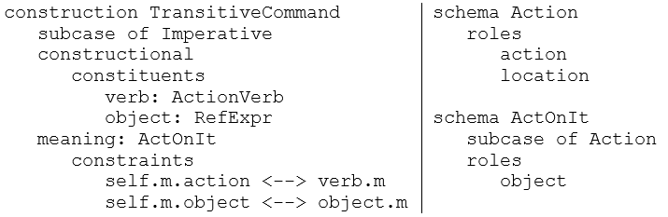
Translating ECG to Soar
Constructions:
Schemas:
Generalize
Recognize form
Evoke meaning
Unify
ActionVerb + RefExpr → TransitiveCommand
TransitiveCommand –evoke-> ActOnIt
ActOnIt –generalize-to-> Action TransitiveCommand –generalize-to-> Imperative
self.m.action ↔ verb.m self.m.object ↔ object.m

Slide 17
End-to-end process
Pick up the green sphere.
Real time
Actionable
1 Pick
2 up
3 the
4 green
5 sphere.
Comprehender
ActOnIt
action: initiate-pick-up1
object: large-green-sphere1
Incremental
Grounded

Slide 18
Pick up the green sphere.
ActOnIt
action: initiate-pick-up1
object: large-green-sphere1
Interpret
Ground
Evoke
large-green-sphere1
ActOnIt
object
pick-up1
block
green1
large1
sphere1
action
Recognize
Transitive Command
Reference
Descriptor
<object>
initiate-pick-up1
Action
Descriptor
PickUp
RefExpr
Property
Descriptor
action
pick-up1
Pick
Verb
color
green1
Ground
PICK
UP
THE
GREEN
SPHERE
Entity
Pick
up
the
green
sphere.
block
sphere1
Construction
Schema
Agent item

Slide 19
A local repair
medium-green-block1
object
Snip
ActOnIt
block
green1
medium1
rectangle1
pick-up1
large-green-sphere1
Reference
Descriptor
ActOnIt
action
object
<object>
Transitive Command
Action
Descriptor
block
green1
large1
sphere1
initiate-pick-up1
Reference
Descriptor
Transitive Command
RefExprPrepPhrase
action
pick-up1
Prep
Relation
?
?
PickUp
RefExpr
!
PrepPhrase
on1
RefExpr
Reference
Descriptor
up
location
Pick
the
green
block
on
the
stove.
stove1
Construction
Schema
Agent item

Slide 20
Approaches to ambiguity
Traditional approaches
Parallel paths
Global optimization
Ranked list of possible parses
Corpus statistics
Can an incremental, single path system resolve ambiguities?

Slide 21
Ambiguity resolution in Lucia
Type | Examples | Resolutions
Lexical | The sphere is green. Put that in the pantry. | Phrasal construction Multiple senses
 | Put the square in the square box. | Local repair
Grammatical | The sphere is green. This is a sphere. | Preference for construction based on context
Structural | Pick up the green block on the stove. | Verb semantics, local repair
 | Put the green sphere in the pantry. | Verb semantics, no local repair
Semantic | Go to the kitchen. | General prep phrase
 | Go down the hall. | Specific prep phrase
Garden path | The horse raced past the barn fell. | Local repair fails -> garden path effect

Slide 22
Evaluating Lucia
Does it work?
130/200 sentences tested against gold standard
Some preliminary simulation tests
Needs more integrated tests with Rosie
Does it scale?
No barriers found in 130 Rosie sentences
Needs testing with wider range of language
Does it match human performance?
It gives correct results on those 130 sentences
It runs at about ½ human reading speed
Needs work to compare to detailed human data

Slide 23
Next Gen (2017?)
Linguistic processing knowledge written by hand
Lexical and construction knowledge translated from ECG
Soar
Long-Term Memories
Procedural
Semantic
Episodic
Reinforcement
Learning
Chunking
Decision Procedure
Episodic
Learning
Working Memory
Visual Buffer
controllers
Perception
Action

Slide 24
Next Gen II (2018?)
Linguistic processing knowledge written by hand
Lexical and construction knowledge learned…
Soar
Long-Term Memories
Procedural
Semantic
Episodic
Reinforcement
Learning
Chunking
Decision Procedure
Semantic
Learning
Episodic
Learning
Working Memory
Visual Buffer
controllers
Perception
Action
Notes:
These two slides will be developed more fully before the tutorial. This is to give the participants the big picture on how Soar works.

Slide 25
Lucia Nuggets & Coal
Nuggets
It works
Incremental processing
Local repair
Embedded in Rosie
Near real-time
Grammar in ECG
It scales
Ambiguity resolution
Garden path effect
Coal
Integration testing
Limited language range
No implicit context
Limited model of human processing
No language learning!

